Slide 2
Interactively Browsing Large image databases
Ronald Richter, Mathias Eitz and Marc Alexa
Notes:
Welcome to my talk about interactively browsing large image databases. This a joint work with Mathias Eitz and Marc Alexa from the TU Berlin.

Slide 3
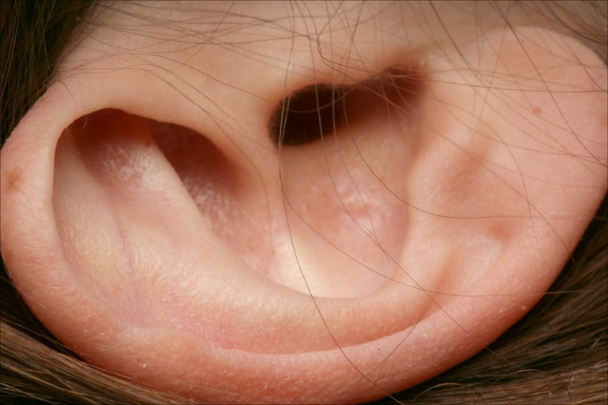
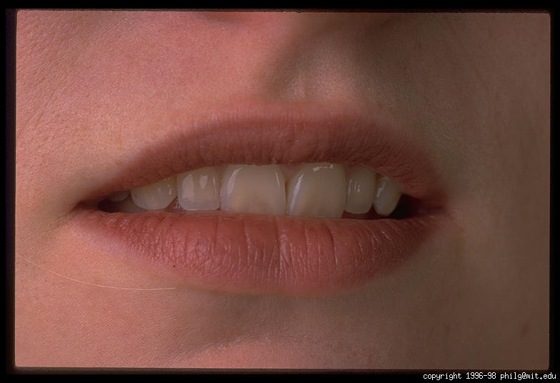
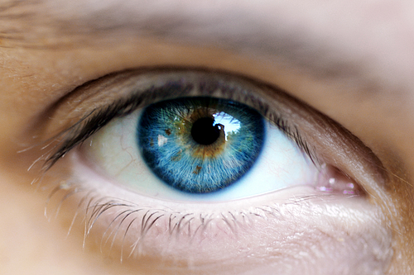
Motivation: Specifying an image
Humans lack communication channel for describing an image
Audio in
Audio out
Image in
Image out
?
Notes:
First I want to give a short motivation, why image retrieval is still a hard problem. (CLICK) Humans are able to receive and produce audible signals. So the common way to communicate with each other is listening and speaking. For visual signals, this is not true. (CLICK) We are able to see and recognize the world around us, but there is no direct way to produce visual output.

Slide 4
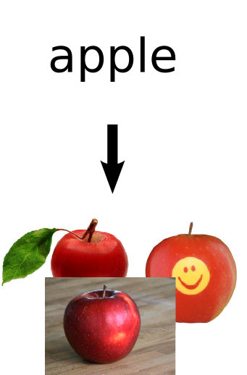
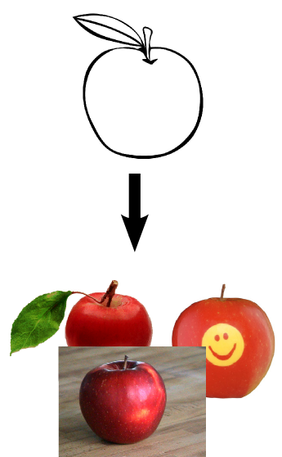
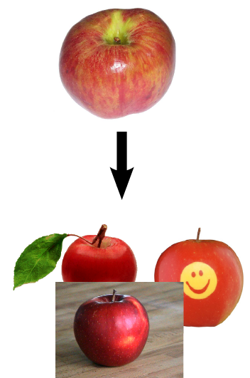
Motivation: Traditional image queries
Queries are typically based on
Words
Existing images
(Hand-drawn) Sketches
This is not how humans
think or
communicate images
Communication is a dialogue
Notes:
This fact leads to the question how to specify a query for an image retrieval system. (CLICK) A common approach, how the user would communicate his request, is to type a keyword and the system returns images which are tagged with the same keyword. By abstracting the image content to words, a compact representation is generated, but the problem here is that every image needs to be manually tagged with keywords.
Therefore content-based methods have been developed.(CLICK) The user can specify a query by providing the system with an example image. However, it is unlikely that the user has an image at hand. (CLICK) A more sophisiticated approach is to sketch a query image, so that the user can express his mental image more directly.
(CLICK)
All of those approaches require that the user exactly knows what he is searching for and is able to communicate that to the system. Also if there is an exact input, the system may not retrieve the desired images.(CLICK) In order to achieve better results, both the human and the system have to communicate with each other.

Slide 5
Human centric image search
Interactive, human-in-the-loop
Basic interaction: browsing
“…exploration of potentially very large spaces through a sequence of local decisions or navigational choices.” [Heesch(2008)]
The image is not like this, more like that
Goal: interactivity with real-world collections
Notes:
The idea is to let the user interact with the system and make him an integral part of the retrieval process. (CLICK)
The basic interaction is browsing , which allows the user to explore “potentially very large spaces through a sequence of local decisions or navigational choices.” (CLICK) So in each step the user says the image is not like that, but more like that. (CLICK) Because humans are able to identify relevant images at a glance, the system should respond fast as well. (CLICK) So our goal is to allow fast interaction with real-world image collections.
To get an idea how the developed system works, i want to show you a video that shows a user interacting with our system

Slide 6
Notes:
So here you can see the user interface. The system presents a couple of images in the middle which are somehow similar to the center image. The center image is the current query image. As you can see the system reacts almost immediately when the user clicks for the next query. The database used here consists of one million images

Slide 7
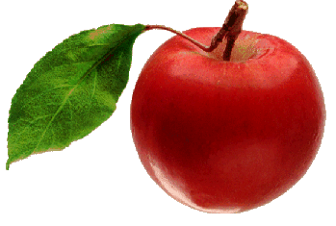
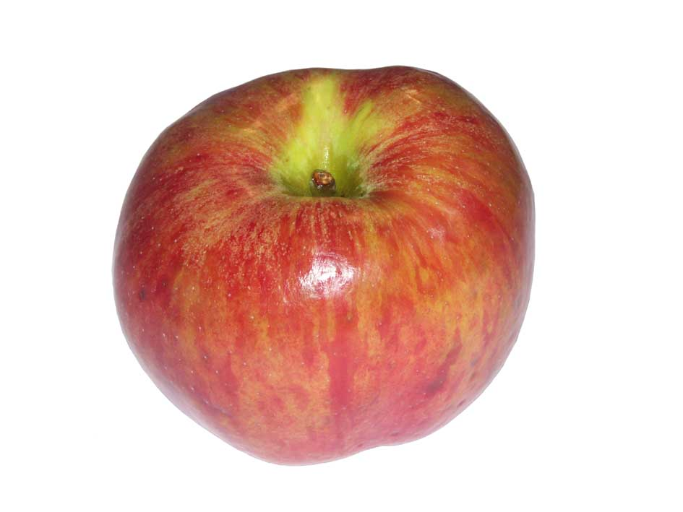
Overview
Current retrieval systems rely on common scheme:
0.21
0.23
0.21
0.13
0.15
0.13
0.75
≈
0.78
0.75
s
s
0.29
0.31
0.31
0.41
,
0.40
0.41
…
…
…
0.15
,
0.17
0.17
Notes:
The basic idea behind nearly all content-based image retrieval systems is to generate a compact description of the image content. (CLICK) The resulting feature vectors are than used to compare images, rather than the actual image content, which is much faster.

Slide 8
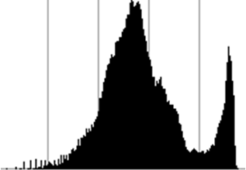
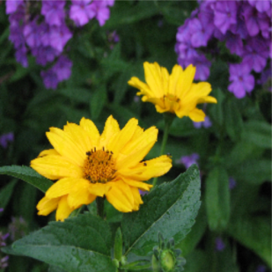
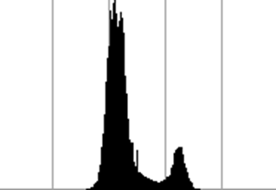
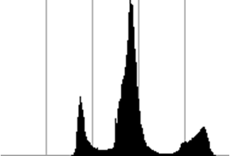
Color Histogram Descriptor
L
a
b
Notes:
Different types of descriptors cover different aspects of the image. To represent the color information of images we used a color histogram descriptor. (CLICK) Therefore the image is converted into the LAB color space and after that a histogram of for each color channel is generated. (CLICK) By concatenating the values of each histogram we get a feature vector.

Slide 9
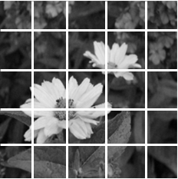
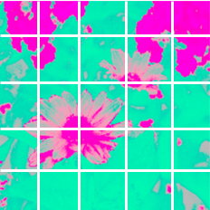
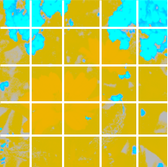
Color Layout Descriptor
L
a
b
Notes:
Another descriptor type is a thumbnail of the image. (CLICK) The image is scaled down and then converted into LAB color space. In contrast to the histogram descriptor, which has only informations about what colors occur in the image, this descriptor is focused on where colors occur. (CLICK) The pixel values of the thumbnail are concatenated to form the feature vector.

Slide 10
Gist Descriptor [Torralba’01]
Notes:
A more sophisticated descriptor type, is the Gist descriptor, which encodes the global structure of an image. The image is filtered by several gabor filter kernels, which have different orientations and sizes. The mean and standard deviation is then computed on the integral image of each filter output and is concatenated to a feature vector.

Slide 11
Nearest Neighbor Search
query
smallest distance corresponds to
most similar image in database
Notes:
After generating image descriptors for all images in the database, we are able to query for similar images by searching for nearest neighbors in feature space. Note that this feature space is typically high dimensional in the order of several hundred dimensions.(CLICK) The naive approach is to compute the distances of a query to all feature vectors in the feature space. This will give us a distance vector, (CLICK) where the smallest value corresponds to the nearest neighbor and so to the most similar image. (CLICK) Because we do that for each descriptor type, we get three separate results.

Slide 12
Combining Features
need to combine nearest neighbor results
linear combination of distance vectors
fixed combination may not reflect the users mental image
+
+
=
Notes:
Until now each descriptor type is handled separately. Using the search results may not cover the whole idea of the query image. So a combination of image features is desired. A linear combination of the distance vectors may lead to better results, but a fixed combination cannot handle changes of the importance of different image features and therefore may not reflect the user’s mental image

Slide 13
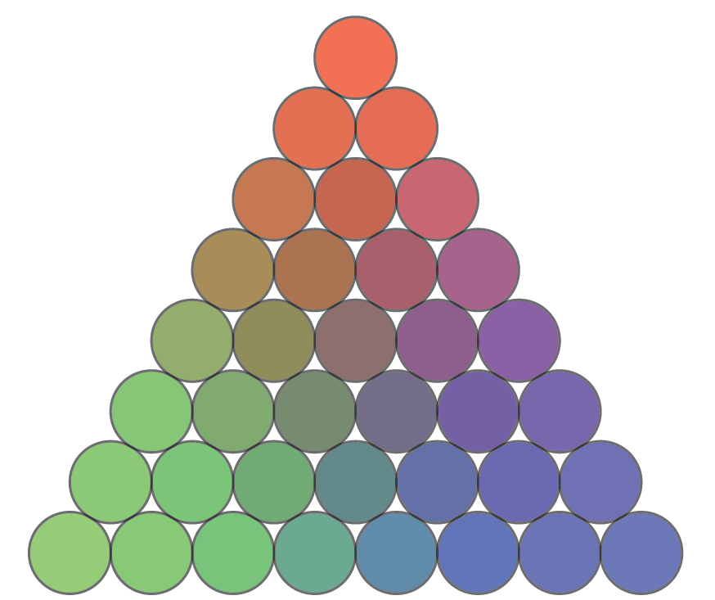
NNk Search [Heesch’04]
importance of each image feature is unknown
use multiple (convex) linear combinations with different weights
1, 0, 0
uniformly sampled weight space
⅓, ⅓, ⅓
0, 1, 0
0, 0, 1
Notes:
Usually the importance of each feature differs by the image content itself or by the intends of the user. So the best matching weighting of the features cannot determined beforehand. (CLICK) Instead using a fixed weighting, the idea is to use all possible linear weight combinations. This leads to the NNk search algorithm introduced by Heesch in 2004. (CLICK) This is an illustration of a uniformly sampled weight space.

Slide 14
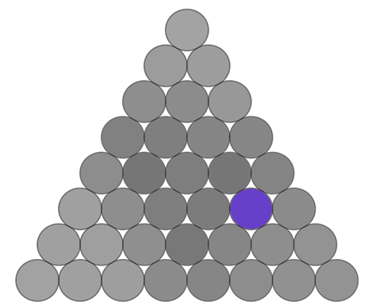
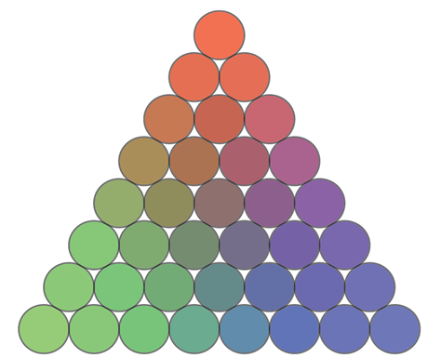
NNk Search
+
+
=
2/6
1/6
4/6
2/6 1/6 4/6
Notes:
Suppose we pick one weight combination out of the weight space (CLICK). With that weighting, the distance vectors are linearly combined (CLICK) which gives us a new distance vector (CLICK). The smallest element corresponds to a nearest neighbor which is then added to NNk search result.

Slide 15
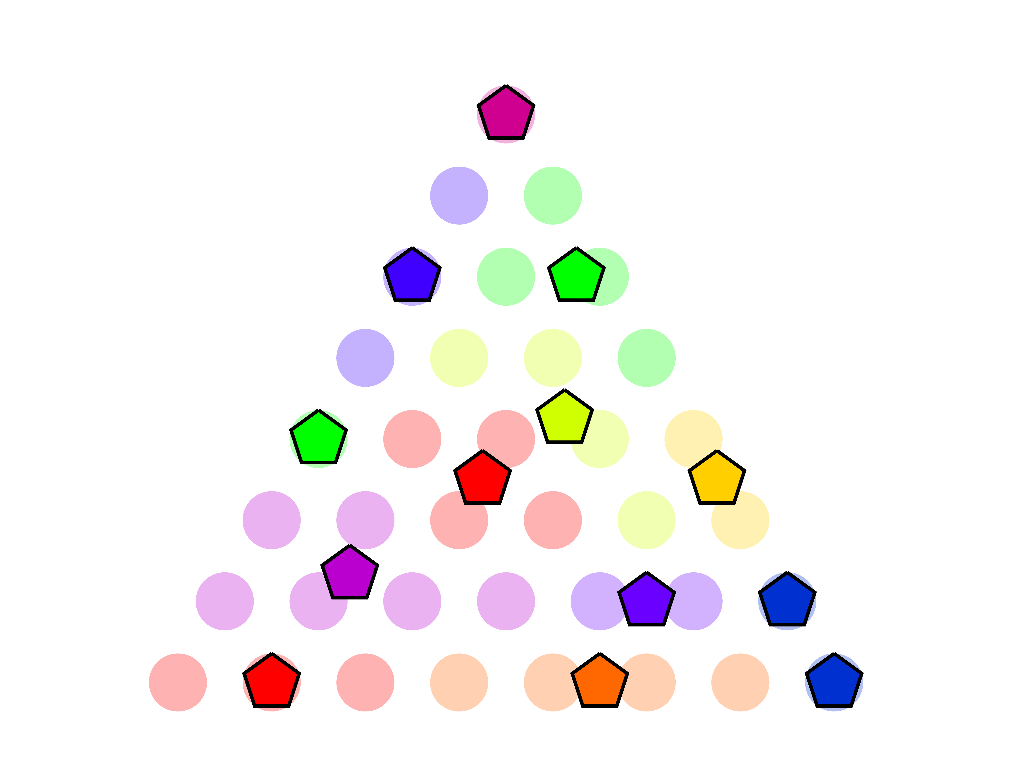
NNk Search
- compute nearest neighbor for all weightings
- set of unique nearest neighbors = NNk result
Notes:
To retrieve the complete NNk set, the previous step is repeated for all weight combinations (CLICK). As a result of the search each combination of weights is now associated with the best matching image in the database. (CLICK) A property of the sampled weight space is, that nearby weightings may have the same nearest neighbor and form a region, as illustrated by the right figure.(CLICK) So the final NNk search result is the set of all unique nearest neighbors.

Slide 16
NNk Search
expensive computation
precomputation possible, but O(N²)
large databases with N > 1,000,000
our contribution:
compute distances only to probable NNk candidates
use fast approximate nearest neighbor search
Notes:
The NNk Search algorithm retrieves more relevant images than a simple nearest neighbor search considering just one feature would do. However, the main drawback of the NNk Search algorithm is its expensive computation, which is linear in the number of the image in the database. (CLICK) Precomputing the NNk neighborship is an option, but is quadratic in the number of images. (CLICK) This quickly becomes infeasible for large databases such as the one we are using, containing one million images.(CLICK)
Our idea is to use a smaller set of probable images for the actual NNk computation. (CLICK) With a fast approximate nearest neighbor search we are able to accelerate the whole search process.

Slide 17
NNk Approximation
Compute NNk on a subset of the database
compute distances for n approximate nearest neighbors
complement missing distances
apply NNk
NNk
Notes:
I will now describe how the NNk search approximation works. Instead of computing the distances for all feature vectors, we do this only on the _n_ approximate nearest neighbors with respect to each feature space. (CLICK) Since the nearest neighbors for each feature might not completely overlap we additionally need compute the missing distances. (CLICK) In our application we only gather 10000 approximate nearest neighbors and perform the NNk computation on that set. (CLICK) As previously this gives us the NNk result. I will show you in a minute that this approximation only slightly decreases precision of the search, but largely accelerates retrieval speed.

Slide 18
K-means tree: construction
[Fukunaga’75]
root
…
…
Notes:
We propose to use a k-means tree to compute approximate nearest neighbors. Assume the points on the left are the high dimensional points we want to index in a k-means tree. This process uses recursive k-means clustering of the data to build a search tree. Initially we cluster all data into _k_ clusters and represent the clusters as nodes in a k-ary tree. (CLICK) (CLICK) (CLICK) (CLICK) Each resulting cluster with a sufficiently large number of remaining points gets recursively clustered and the points in a parent node are distributed to its child nodes. (CLICK) (CLICK)

Slide 19
K-means tree: query
[Fukunaga’75]
query result:
root
…
…
q
Notes:
Given the k-means tree that we just built, how do we compute the approximate nearest neighbors, given a query point q (CLICK)? We use a best bin first strategy to quickly retrieve our result. This means that we visit the nodes in order of the distance to the query point. As soon as we have gathered the desired number of results, the traversal gets stopped. I will now show you an example of querying five nearest neighbors. We start at the root node (CLICK). As you can see on the left the nearest cluster to the query is the gray one (CLICK). Now we have found two additional cluster which we visit again in order of the distance to the query. (CLICK) After finishing this subtree, the next nearest subtree is the green one (CLICK). Now we have gathered the desired five nearest neighbors. (CLICK)

Slide 20
Results
10K approximate nearest neighbors, 1M images
precision: 85%
speed: 267 ms
Notes:
Here are some numbers of the resulting precision and performance of our system when searching in a collection of one million images. When using the k-means tree to search for 10000 neighbors we still reach a precision of 85%. This means that 85 % of the images returned using our approximated nnk search are similar to those returned by the exact search. However the query is now interactive and takes only a fraction of a second.

Slide 21
Notes:
This is how our user interface looks like. The query image is shown in the middle and the corresponding query results are overLAYED over the nnk weight space. In the bottom half of the surrounding circle we show a history of the browsing process. in the top half we additionally show completely random images – I will show you in a minute why this can be important.

Slide 22
video
Notes:
Here is a video were the user interacts with the brower interface. Additionally the NNk weight space is shown in the background. The user clicks on the image he is interested and the system queries for similar images. (PAUSE) This is repeated until the user has found the desired image.

Slide 23
Limitations - Video
Notes:
Okay, now i will show you a video which illustrates a limitation of the NNk Search

Slide 24
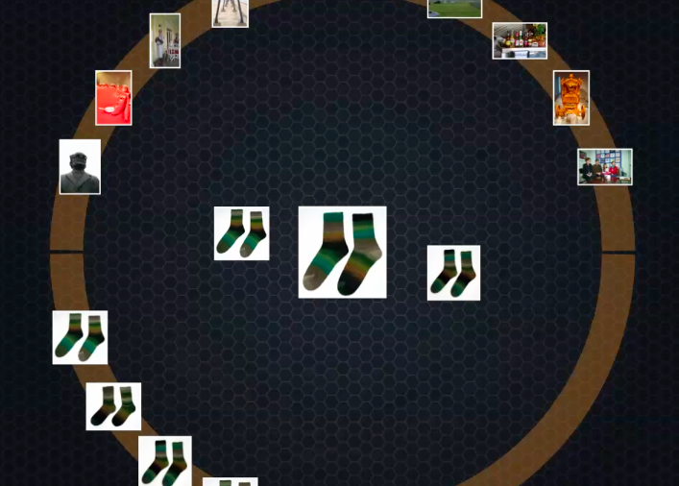
Limitations
Notes:
SO what happend here? Lets have look at the images in the result set. (CLICK) The images are not the same, but similar to each other with respect to the features we are using. This means that for any weight combination only those images can ever be retrieved as the best matches. For that situation, random images are additionally offered in the upper half circle.

Slide 25
Future Work
Out-of-core data structures
handle even larger image collections
Localized Browsing
fix image parts as prior for next search
Evaluation
reachability of all images
number of iterations to desired image
Notes:
Okay let me talk a little about future work. We would like to represent our index data structure out of core – This would allows to handle even larger image collections on the given hardware.(CLICK) Second we want to localize the browsing. This would involve fixing parts of an image -- using for example a multitouch interface -- and using those parts as a prior for the next search. (CLICK) Third, we are interested in evaluating whether all images in the collection can actually be reached using the interface. And finally we would like to evaluate whether any image can be reached within a fixed amount of browsing steps.

Slide 26
Thanks!
Notes:
Thats the end of my talk. Thank you very much.

Slide 27
Notes:
eVALuate
per-cent
spässify
apprOach
räpresent
ocör
di-törman
respect
gAther

Slide 28
NNk Search
Step 2: Normalize distances
mean = 0
std = 1

Slide 29
NNk Search
1:1:1
1:0.5:1.5
1.5:1:0.5

Slide 30
NNk Search
1.5:1:0.5

Slide 31
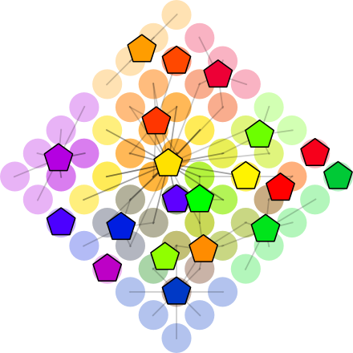
NNk search result visualization

Slide 32
Feature Space

Slide 33
Feature Space
Euclidian distance
Manhattan distance
Similarity between
Images

Slide 34
System Overview
Image
descriptors
Index
structures
Color histogram
k-means
tree
Approx. NNk search
Browser
Image
database
Color
layout
k-means
tree
Gist
k-means
tree
Search
algorithm
User
interface
Offline computation

Slide 36
Results: Precision

Slide 37
Results: Precision

Slide 38
Results: Speed
1 million images in database
approximation uses 1% of probable images

