Slide 1
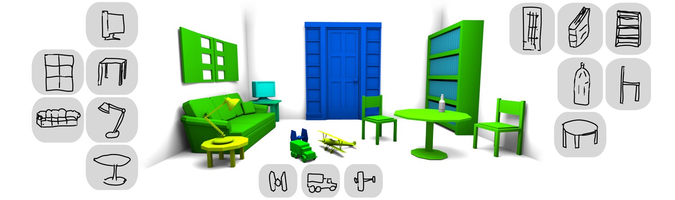


Sketch-Based Shape Retrieval
Mathias Eitz
Ronald Richter
Tamy Boubekeur
Kristian Hildebrand
Marc Alexa
TU Berlin
TU Berlin
Telecom ParisTech
TU Berlin
TU Berlin
Notes:
I will be presenting you our work on sketch based shape retrieval and this is joint work with Ronald Richter, Tamy Boubekeur, Kristian Hildebrand and Marc Alexa.
(CLICK->next slide)

Slide 2
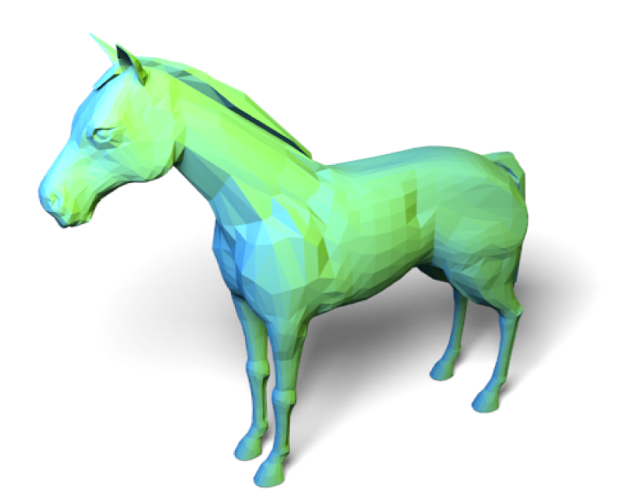
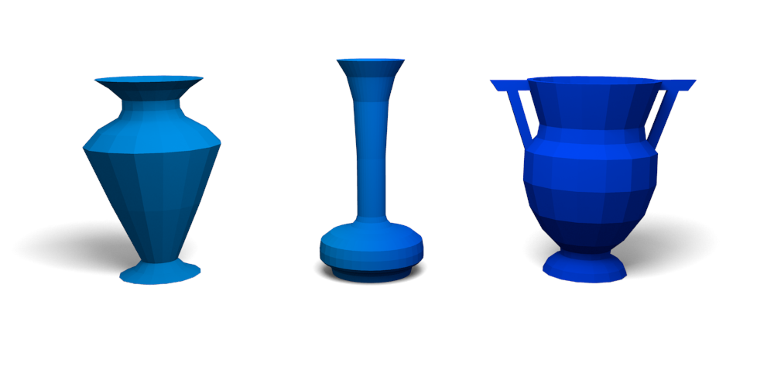
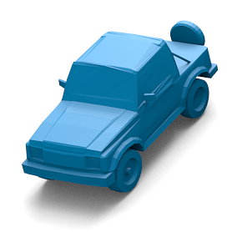
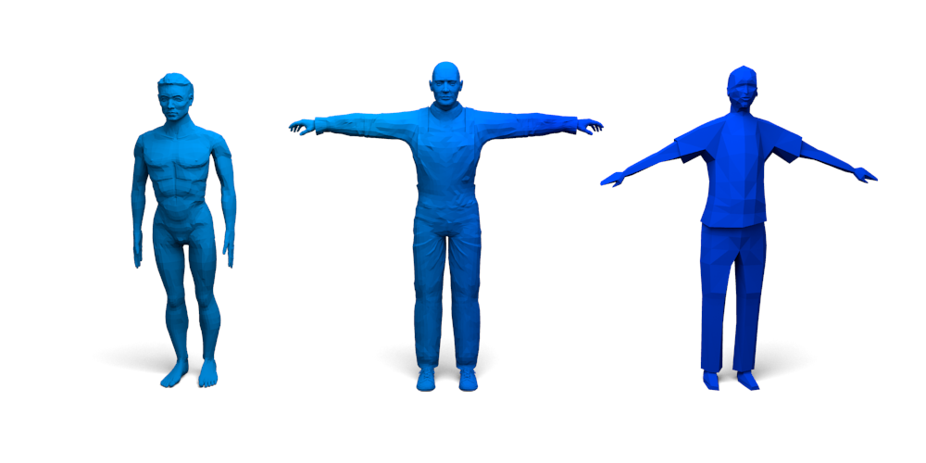
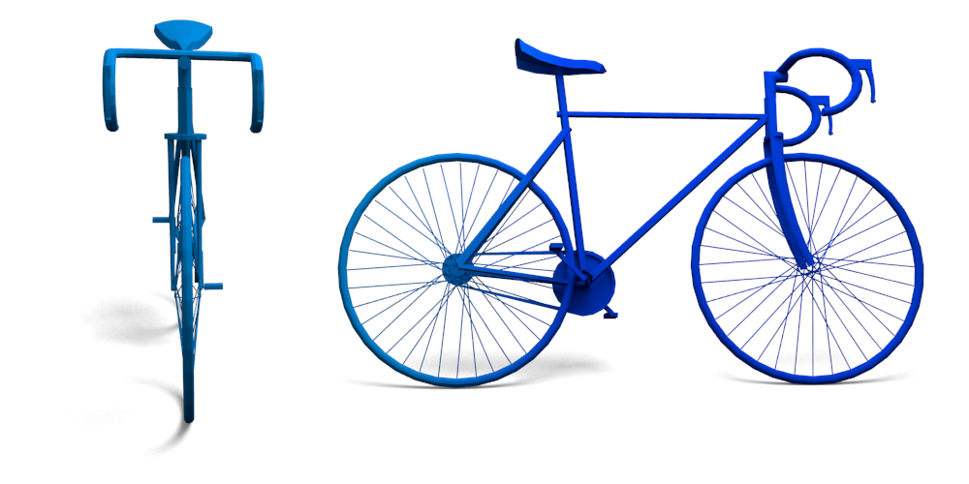
Overview
...
...
...

Slide 3
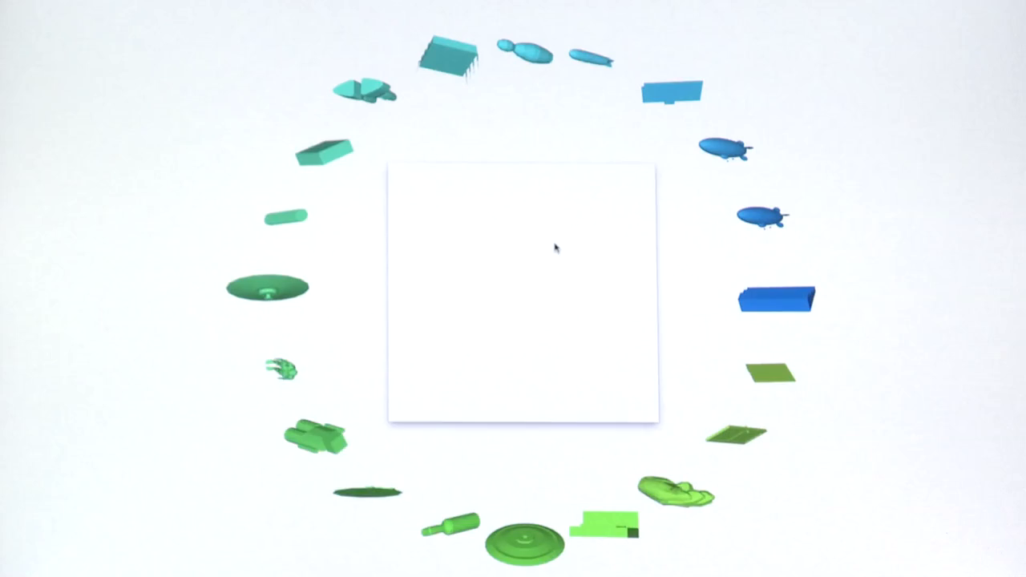
Notes:
To give you some more intuition, here is a short video showing the resulting system in action. Users draw a sketch and the system is fast enough to interactively display matching models from a large dataset of models.
(CLICK->next slide)

Slide 4

Why Sketch-Based?
car
Problems:
  vehicle, jeep, truck, pickup, ...
  no keyword attached to model
Notes:
Why sketch-based retrieval? There are exisiting repositories of annotated sketches for which search is extremely efficient. Why don‘t we just use those? It‘s very simple, type in a car and you get the corresponding model (CLICK).
However, there is a catch: for many models, a large number of other labels might be attached to this model, e.g. vehicle, jeep, truck or pickup. Also many models do not carry any labels and for those, sketch-based retrieval is possibly the only option.
(CLICK->next slide)

Slide 5
Why Sketch-Based?
Easy to sketch, difficult to describe
Notes:
And sometimes, it‘s just easier to sketch the desired shape rather than trying to express it with words for example for this different postures here.

Slide 6
Why Sketch-Based?
Easy to sketch, difficult to describe
Notes:
How would you describe those shapes with words?

Slide 7
Challenges
What to match the sketch lines against?
Sketch is a projection, information lost
Need to support all possible viewing directions
Handle extreme abstraction/exaggeration
Notes:
We can now define our problem: we need to relate abstract sketches such as the one shown here to a 3D model (CLICK). This is actually quite difficult due to several reasons:
* How can we match the sketch lines against the 3D mesh? (CLICK)
* The sketch is a projection, so we lose information about depth ordering (CLICK)
* We do not know the view direction of the sketch a priory, so we need to be able to handle all possible directions (CLICK)
And finally, sketches are almost always not realistic depictions of the original, in this case, for example, the tail is way too large
(CLICK->new slide)

Slide 8
How Do Humans Sketch for Shape Retrieval?
Questions:
  Type of lines humans draw, are outlines enough? [Chen 2003]
  Consistent quality?
  Realistic/abstract?
User study on Amazon Mechanical Turk
  Interactive drawing tool
  Asked for a total of ~2,000 sketches in 90 categories
  Categories from Princeton Shape Benchmark [Shilane 2003]
Notes:
So the first thing we needed to know when we started this project was how do humans sketch for shape retrieval? Several important questions here are:
What kind of lines do people draw for shape retrieval, for example earlier research by Chen and coworkers suggests that outlines are enough.
How consistent is the quality of sketches among humans
And finally, how realistic are those sketches with respect to the original shape?
(CLICK)
To analyze this, we performed a perceptual study on Amazon Mechanical Turk. We provided workers with an interactive drawing tool and asked them to sketch an object given the name of one of about 90 categories. We used the categories from the Princeton Shape Benchmark, which is an established dataset in the shape retrieval community.
On the next slide I will show you a subset of all the sketches gathered in this experiment.

Slide 9
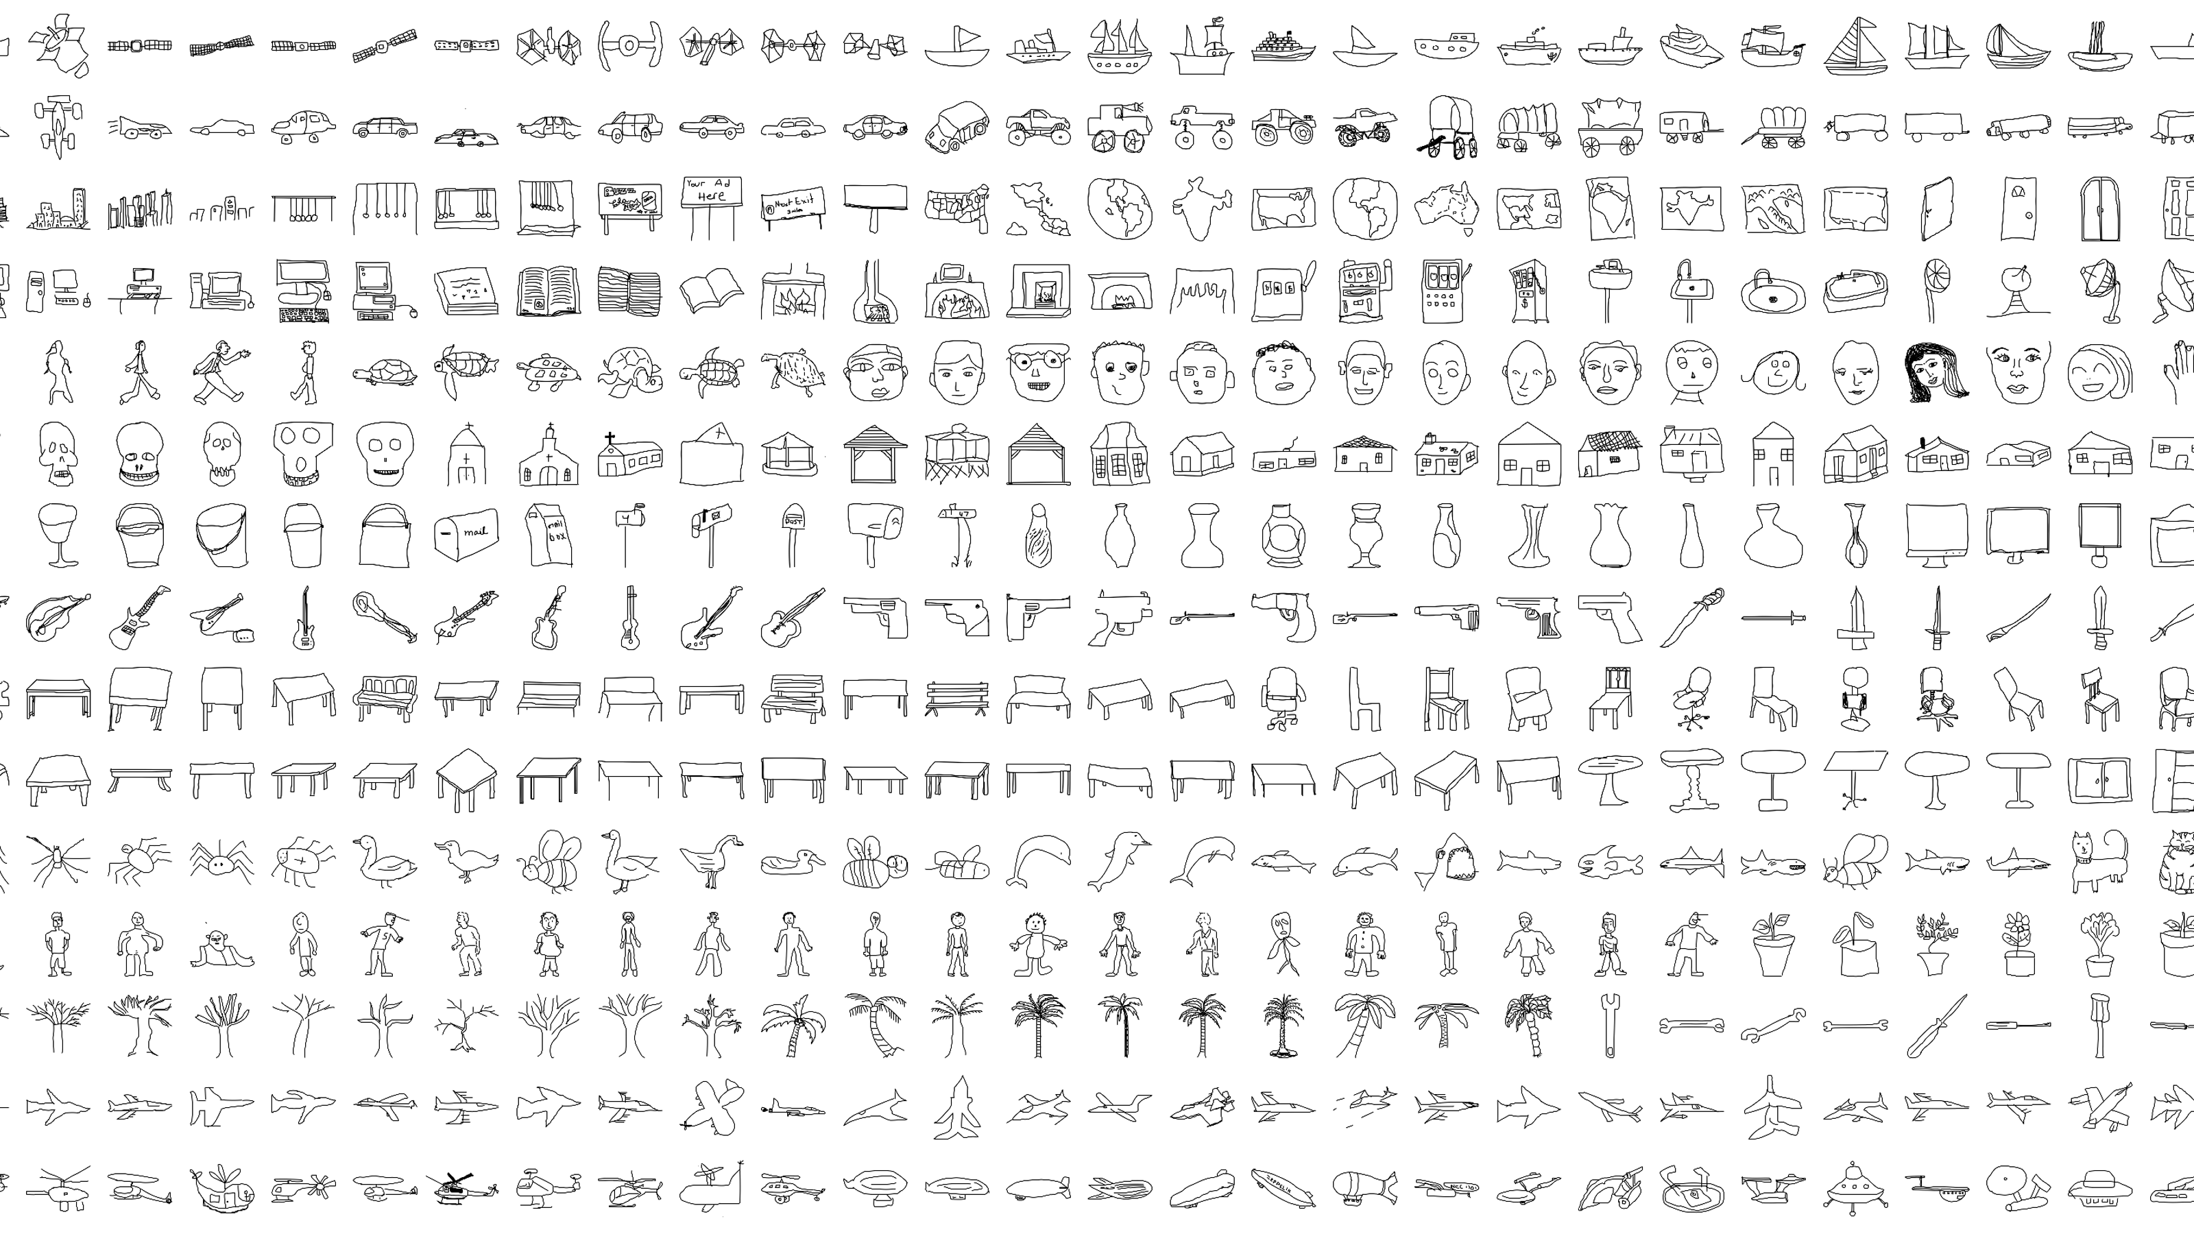
Notes:
This slide shows about 20% of the full dataset.
(CLICK->next slide)

Slide 10
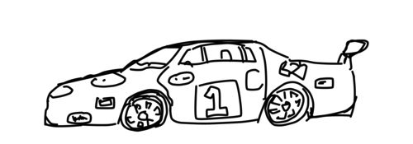
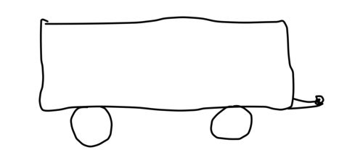
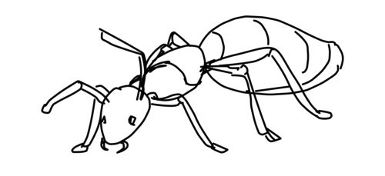
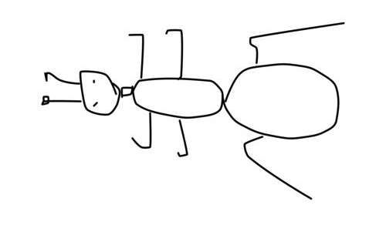
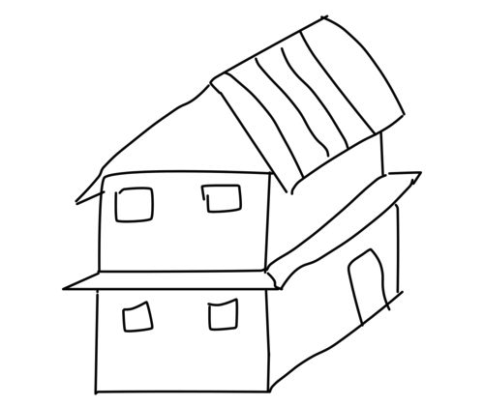
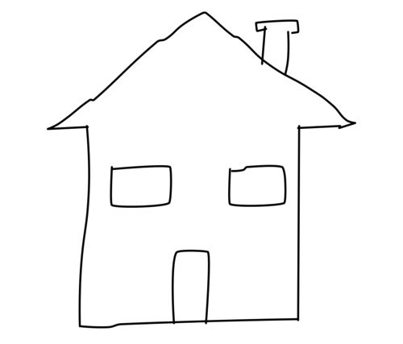
How Do Humans Sketch for Shape Retrieval?
Large variety of sketching styles:
outlines
interior lines
abstract
realistic
no perspective
perspective
Notes:
So as a result of our experiment, we found that people sketch shapes using a variety of differing styles (CLICK)
Some sketches use outlines only while others feature many interior lines (CLICK)
Some sketches are quite abstract while others can be very realistic (CLICK
And finally, some sketch don‘t use perspective while others do
This suggest that we need a retrieval algorithm that can handle all those cases, and, inparticular, one that can handle arbitrary lines rather than just outlines.
(CLICK->next slide)

Slide 11
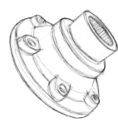
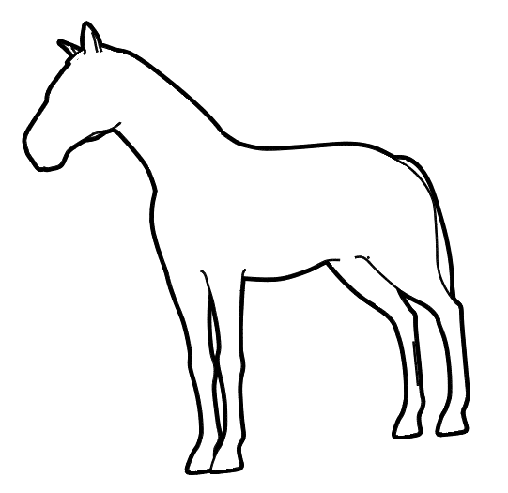
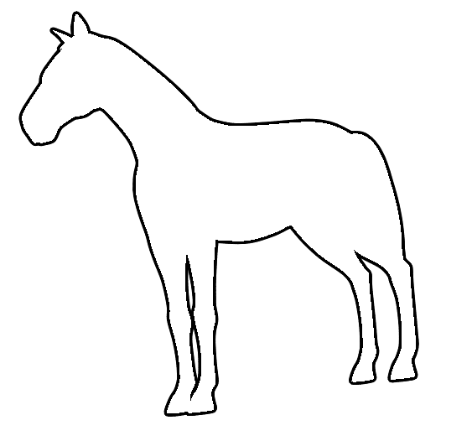
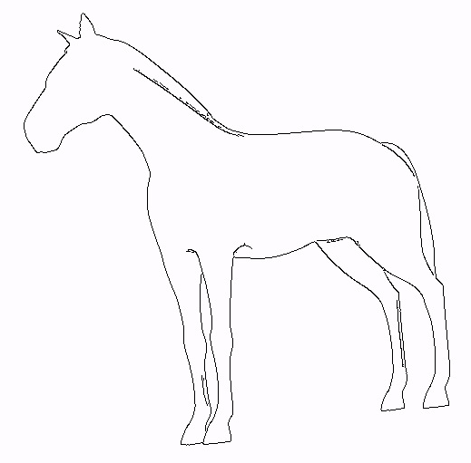
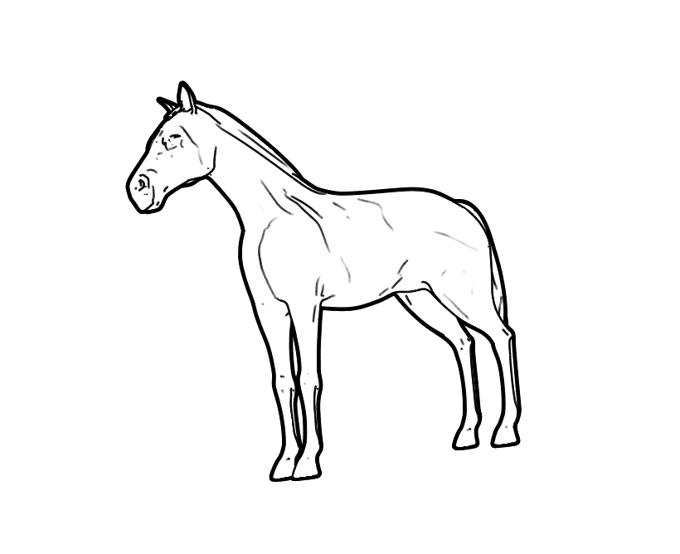
View-Based Approach
View-based instead of direct matching to 3D shape
  [Bülthoff‘92]: humans represent shapes using 2D views
  [Cole‘07]: 90% of lines explained by NPR algorithms
Occ. Contours
[Hertzmann 2000]
Depth Canny
[Canny 1986]
Suggest. Cont.
[DeCarlo 2003]
Silhouette
Notes:
So remember the first point from the previous slide: we somehow need to match the sketch to a 3D model. We propose a view based apprach rather than a direct mapping of the 2D sketch to 3D. So given this mesh of a sketch (CLICK) we select a view and extract a set of line-drawings out of it (CLICK). This reduces the problem to matching two line drawings. In particular, the line types we extract are: Silhouettes, Occluding Contours, Canny lines from the depth map as well as Suggestive Contours. In the paper, we evaluate what kin dof lines work best and find that Suggestive contours perform slightly better than the rest.
There are several good reasons for performaing matching in 2D rather than in 3D: (CLICK)
First of all, there is experimental evidence that humans actually do the same and represent a 3D model using just a few views. (CLICK)
And also, conveniently for us, recent studies have shown that 90% of all lines drawn by artist can be explained by current computer line drawing algorithms. This means we can use those line drawing algorithms to produce a rendering that is pretty close to how a human would have drawn it.
(CLICK->next slide)

Slide 12
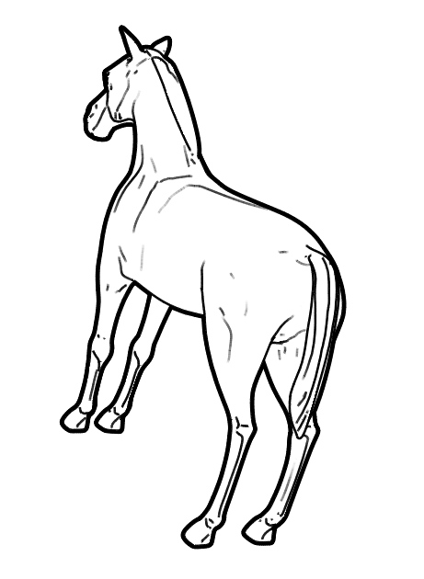
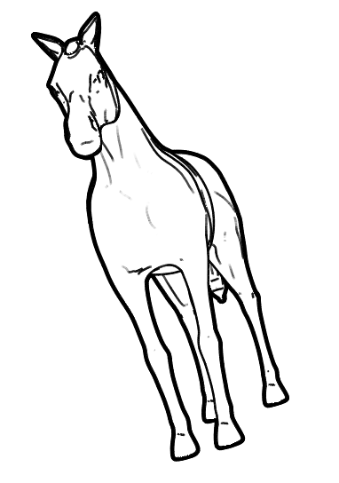
View Generation
Notes:
As I have mentioned before, we don‘t know from which direction our users are going to sketch an object. So it is essential to make sure that we capture all possible direction. To do so, we generate sample points on the bounding sphere of the mesh (CLICK) and use those as positions for the camera looking into the center of the mesh. (CLICK). This gives us a set of views which we render using a given line drawing algorithm. The final choice we need to make is the camera up-vector and we randomly select this. As a result, nearby views have different orientations (CLICK) and this approximates a global rotation invariant encoding.
(CLICK->next slide)

Slide 13
Similarity Measure
similarity
,
Requirements:
Tolerate local and global deformations
Support partial matching
Fast and efficient
Need appropriate feature transform
Notes:
We now have represented each mesh using a number of 2D images and our task is reduced to comparing a user sketch to a computer-generated line drawing. In other words, we need to define a similarity function (CLICK). A very simple measure would be to compute the sum of squared differences between the two bitmap representation, but this is know not to work well due to the following reasons:
* there is a lot of abstraction in the sketch
* the sketch typically only contains a subset of the feature lines available in the computer-generated linedrawing.
Finally, the matching should be very efficient as we potentially need to run it on a large number of models.
As a consequence, we encode our sketches first, using a feature transfrom that ideally has all those properties.
(CLICK -> next slide)

Slide 14
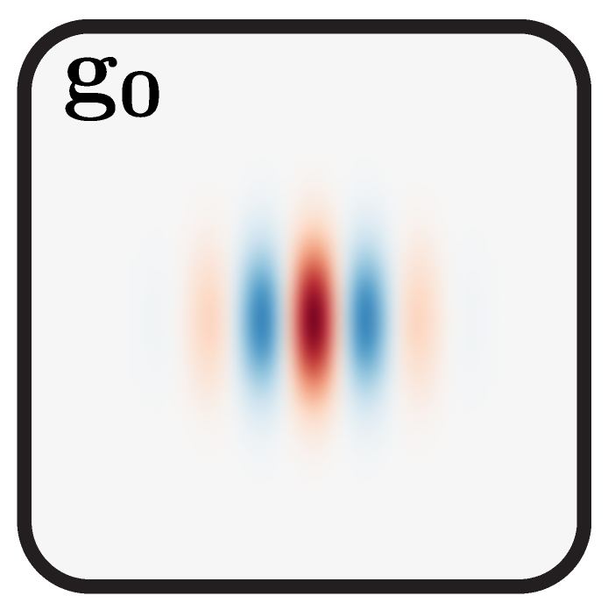
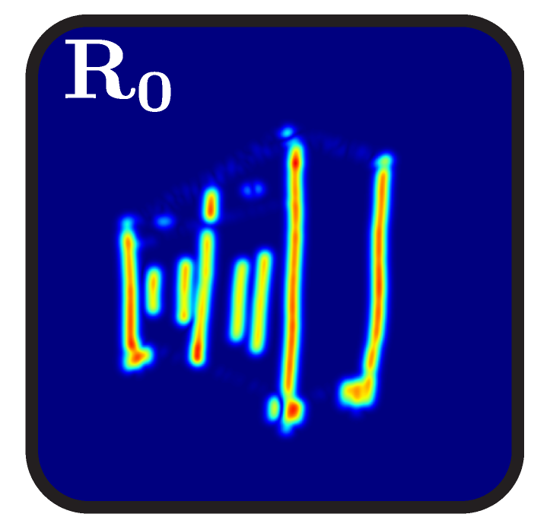
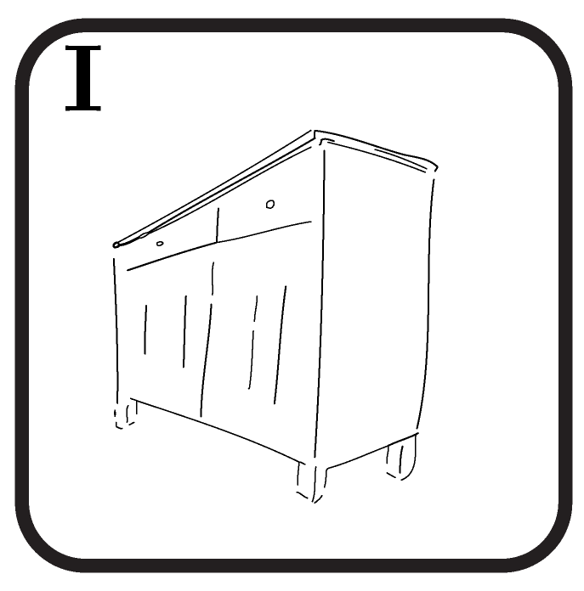
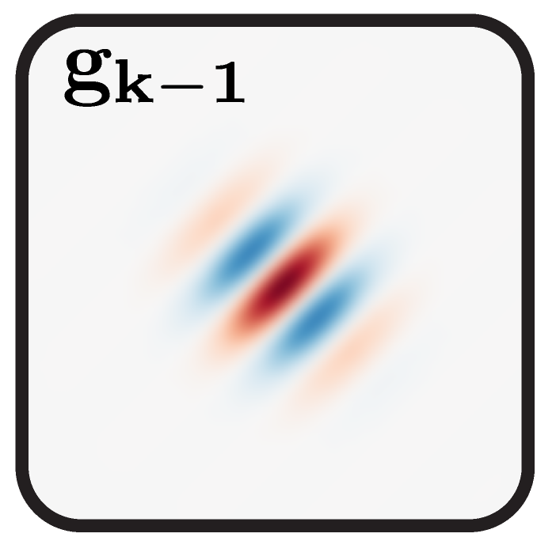
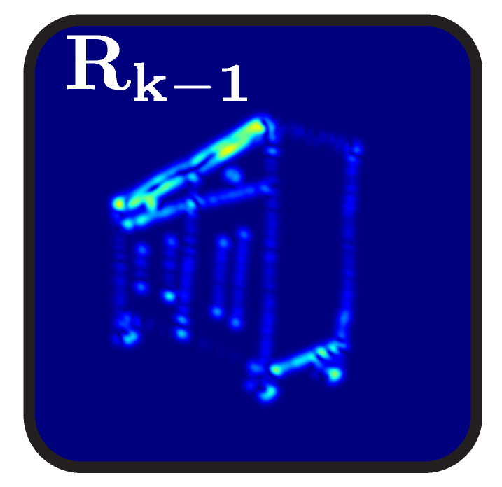
Local Feature Extraction
sketch
bank of Gabor filters
responses
*
...
...
Notes:
On this slide, I will show you our local feature definition. Given a sketch, we convolve this with a Gabor filter having a certain orientation and peak frequency response (CLICK). I will give you a bit more detail about this filter in a minute. This gives us a response image (CLICK) with high response values for those image elements that correspond to the selected orientation and frequency. Of course, there are lines at many different orientations in a sketch and we thus additionally convolve the sketch with Gabor filters having different orientations (CLICK). Overall we typically use in the order of 4-8 orientations.

Slide 15
Local Feature Extraction: Gabor Filter
spatial domain
frequency domain

Slide 16
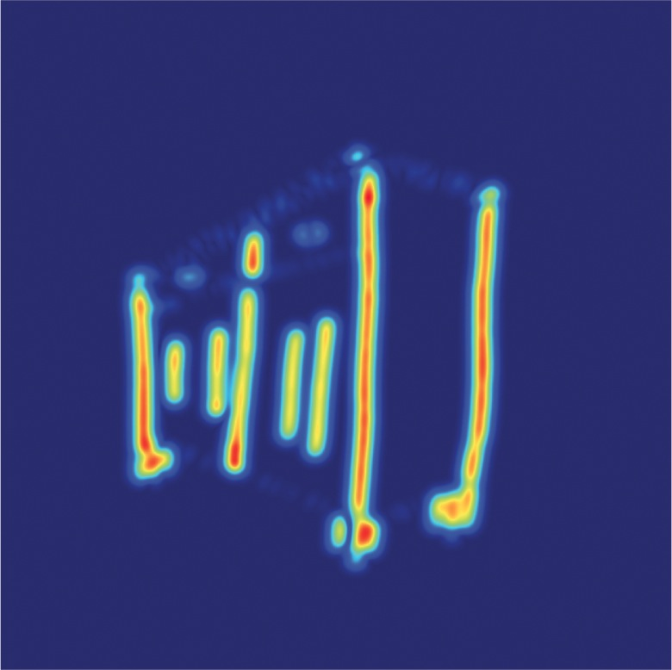
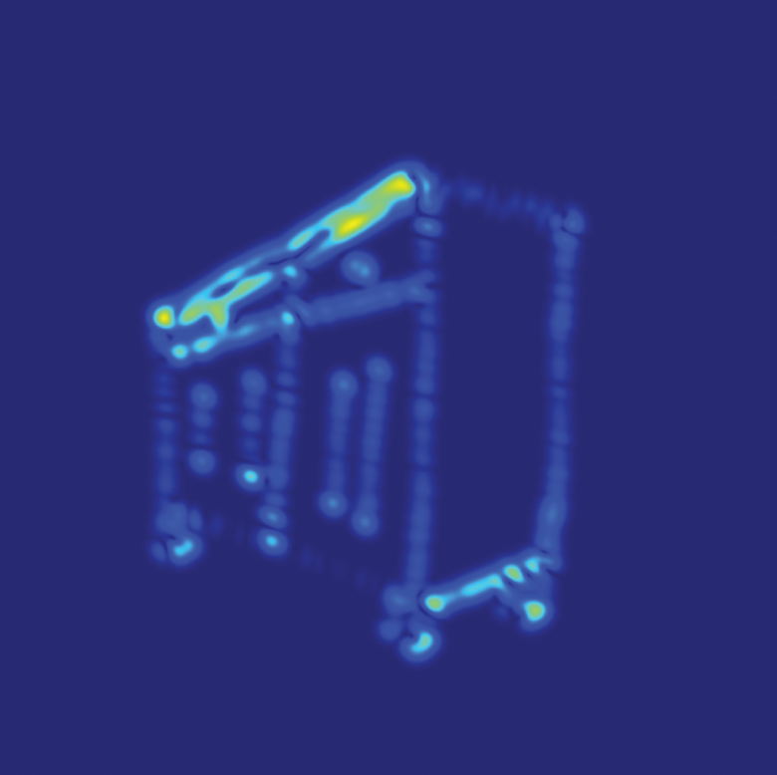
Local Feature Extraction
...
...
...
...
...
,
, ... ,

Slide 17
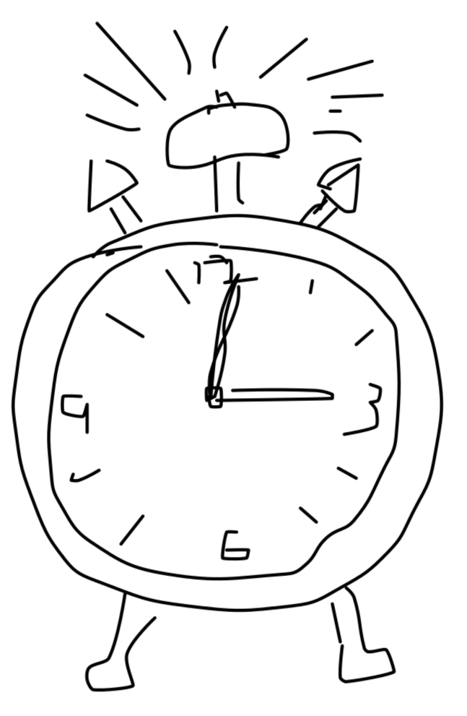
Quantization Using Visual Vocabulary
a) sketch
b) local features
c) single feature vector
2
1
1.000 dimensional
...
...
...
2
quantize
…
,
, ... ,
Notes:
So given this sketch, I have shown you on the previous slides how to extract a set of local feature (CLICK). This representation is still very high dimensional because we typically extract 1000 local features each of which is 64-dimensional. We want to further reduce this into a single feature vector that describes the sketch. To give you some intution, this feature vector is roughly 1000-dimensional.
This additional step will not only make the feature vector much lower-dimensional but also makes the representation translation invariant.
CLICK -> next slide

Slide 18
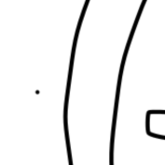

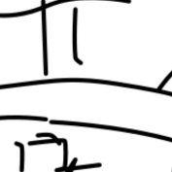
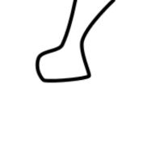

Bag-of-Features Representation
2
1
2
local features
visual vocabulary
feature vector
…
…
Notes:
We perform the following steps: First we generate many sample locations in image space (CLICK). Next we extract small rectangular image patches at those sample locations (CLICK 5x). Note that we have now transformed the sketch into a set of local image patches, with no information about at which spatial location those patches appeared in the sketch. This is why this is called a bag-of-features representation. As the next step, we represent each patch as a histogram of edge orientations (CLICK) …
(CLICK->NEXT SLIDE)

Slide 19
Search
similarity
,
2
2
1
0
2
3
…
…
,

Slide 20
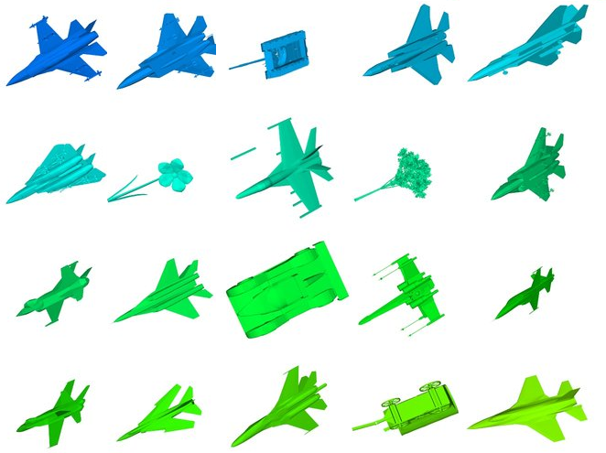
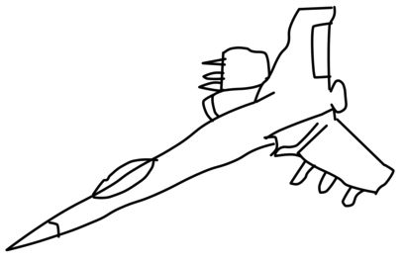
Establishing an Objective Benchmark
First large benchmark for sketch-based 3d shape retrieval
  1) query:
  „fighter jet“
  2) count matches:
  „fighter jet“
  3) precision/recall
Notes:
Now how can we evaluate the performance of our approache and compare it to previous approaches?
Given the sketch dataset I will now show how we made use of our sketch dataset to establish the first large-scale objective benchmark for sketch-based shape retrieval. Given a query sketch (for we we know the category) (CLICK) we run the retrieval engine. Next we count the number of correct matches, i.e. those that belong to the same category as the query (CLICK). This is a very standard procedure in information retrieval and lets us compute measures such as precision recall. We can then average the precision/recall curves for all query sketches to get one curve per system.

Slide 21
Comparison to Existing Systems
Competing systems have been optimized as well!
Our approach
Notes:
So here are several final precision/recall curves that compare our system to other ones. For all systems – even the competing ones – we used the parameters that resulted in best performance.
All curves have been computed using the test dataset which has not been involved in the optimization. The curve you see here is the precision/recall curve you get when randomly returning shapes. So here is the firt surprise: we used the very popular SIFT feature detection/descriptor pipeline to compute SIFT features for our sketches. This turns out to not work very well. It is unclear what a sclae-space on sketches actually is and the scale-ivariant feature detector often returns very few keypoints for the sketches. So what happens if we sample keypoints on a regular grid instead? (CLICK) We get much better results. Here‘s the results for three other competeting approaches (CLICK, CLICK, CLICK). And here‘s our approach, which gives significantly better results.

Slide 22
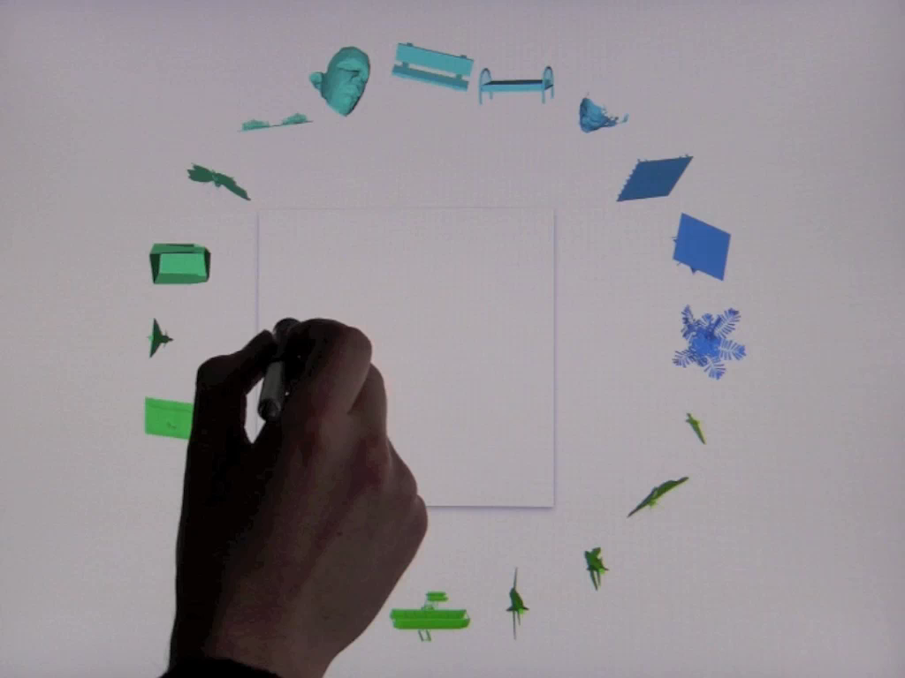

Slide 23
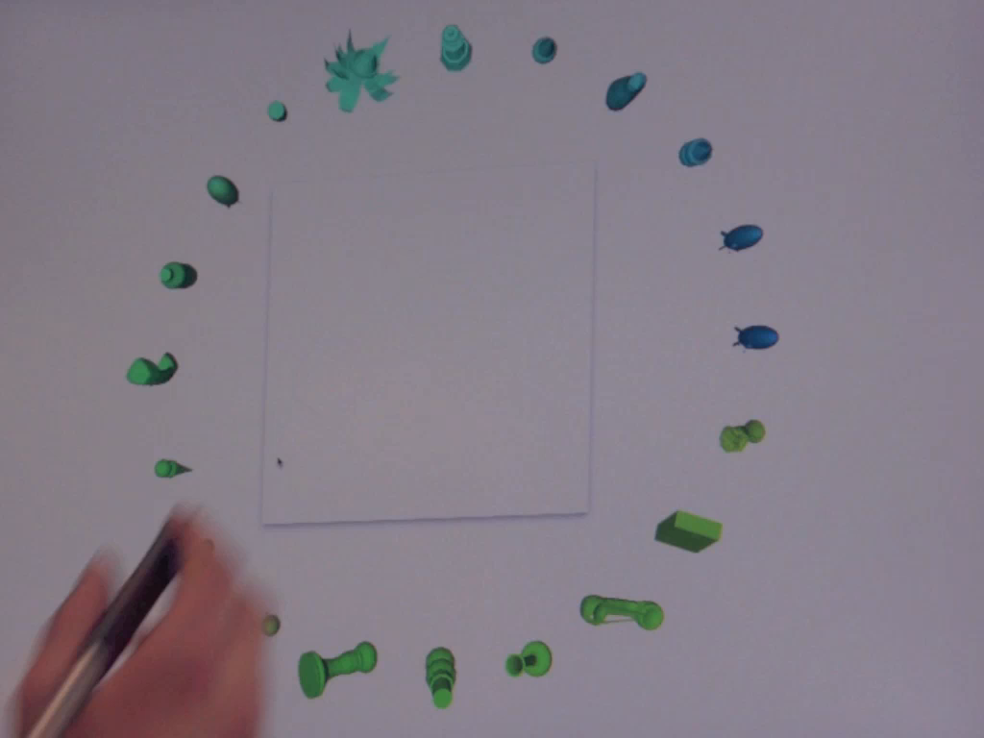

Slide 24
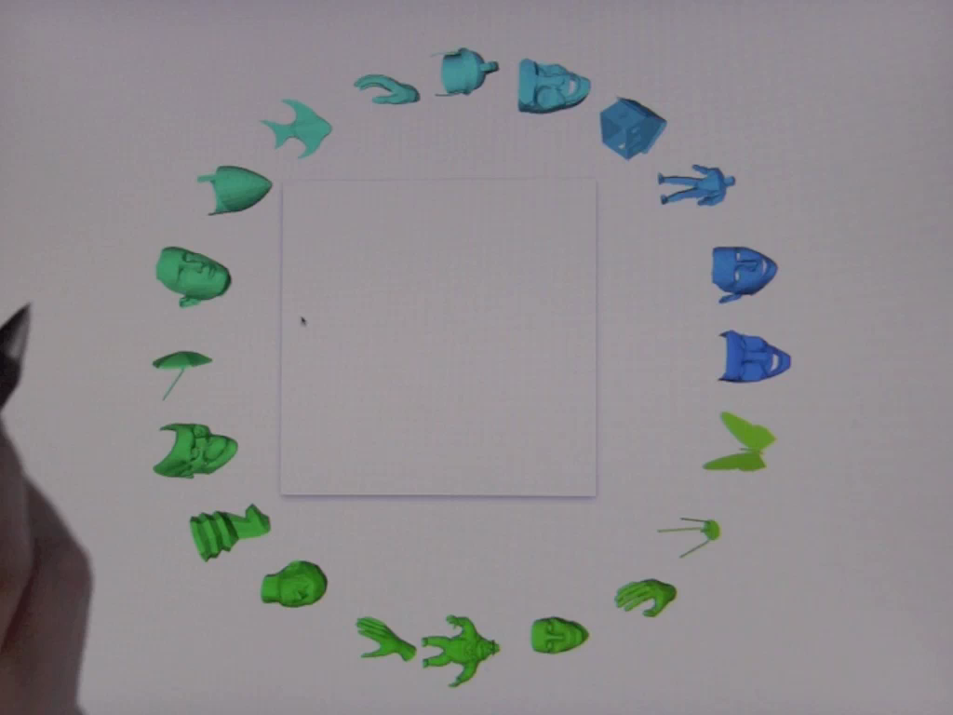

Slide 25
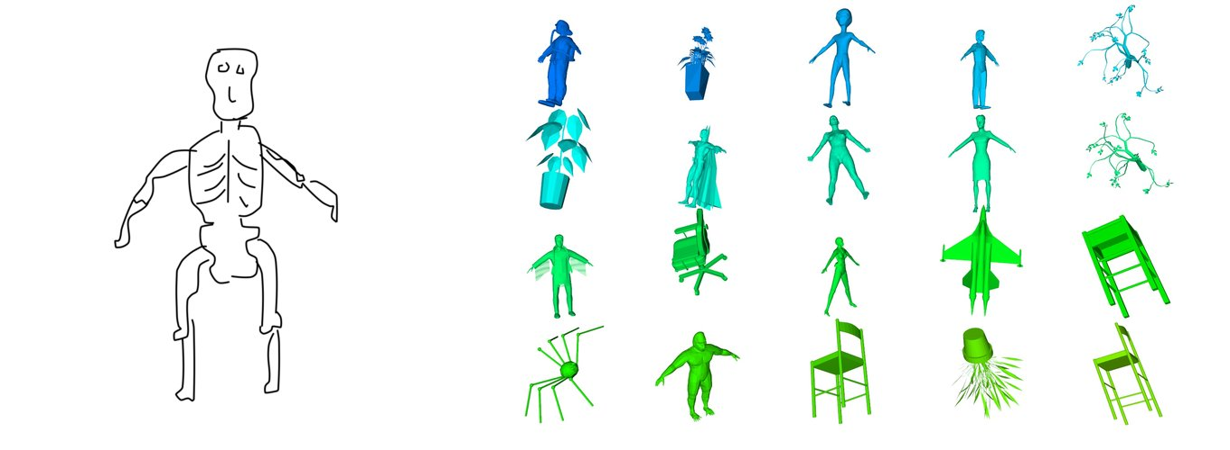
Failure Case
Notes:
So here is a typical failure case of our system: although the results roughly have the right shape, no human skeletons are within the first 20 results. Our system is purely based on geometric matching and has no notion of semantics.
(CLICK -> next slide)

Slide 26
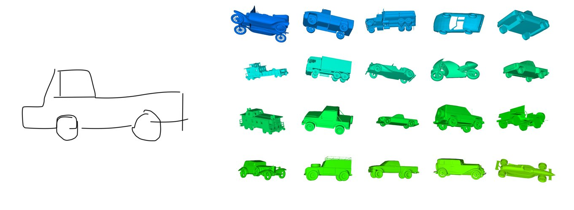
Partial Matching

Slide 27
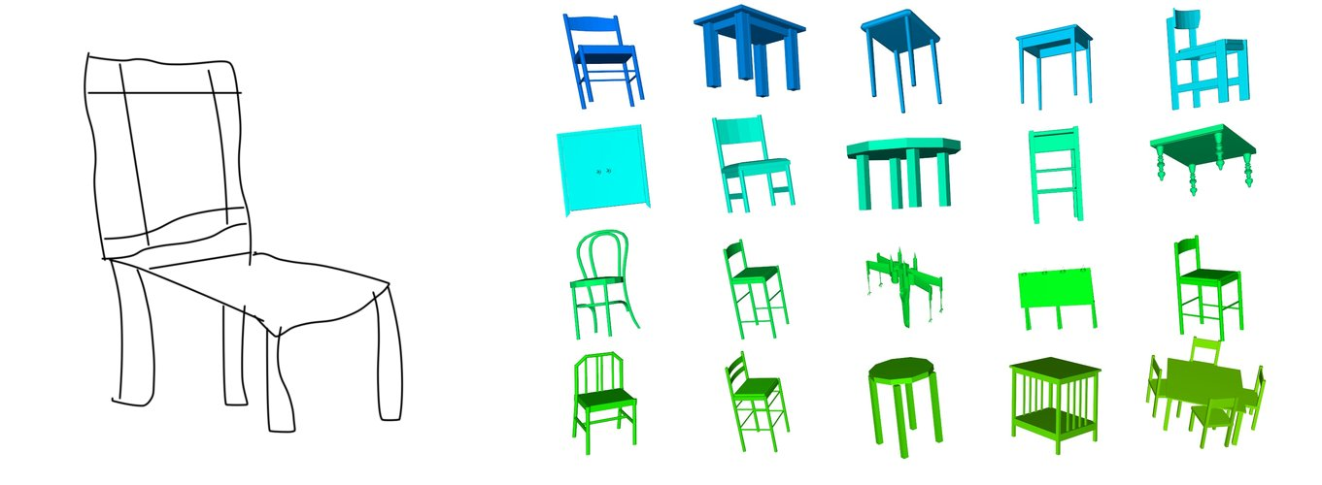
Partial Matching

Slide 28
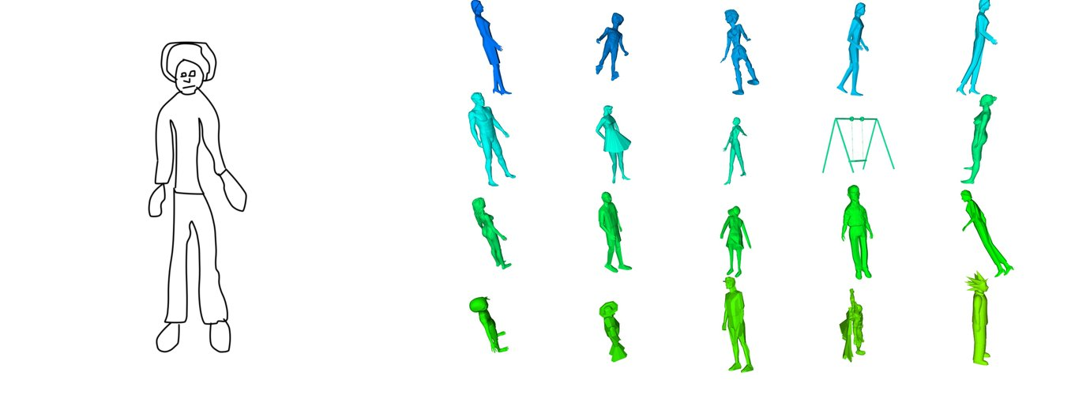
Easy to Sketch, Difficult to Describe

Slide 29
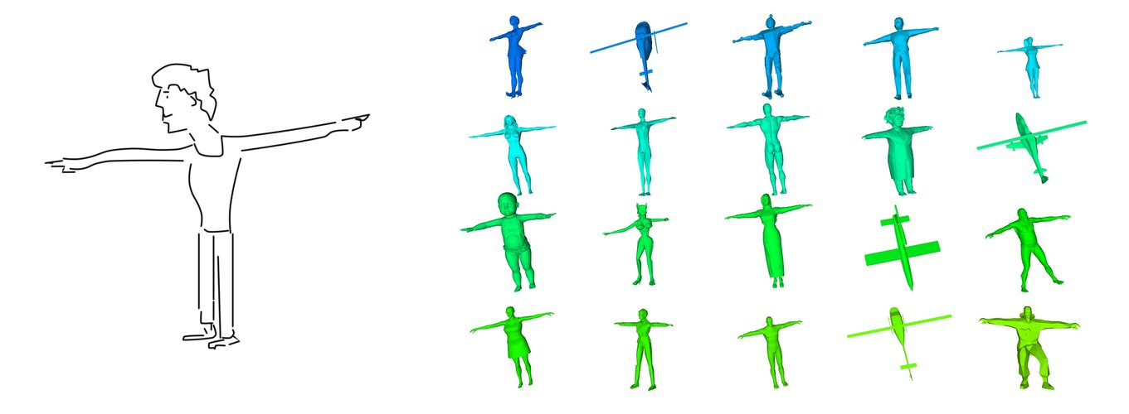
Easy to Sketch, Difficult to Describe

Slide 30
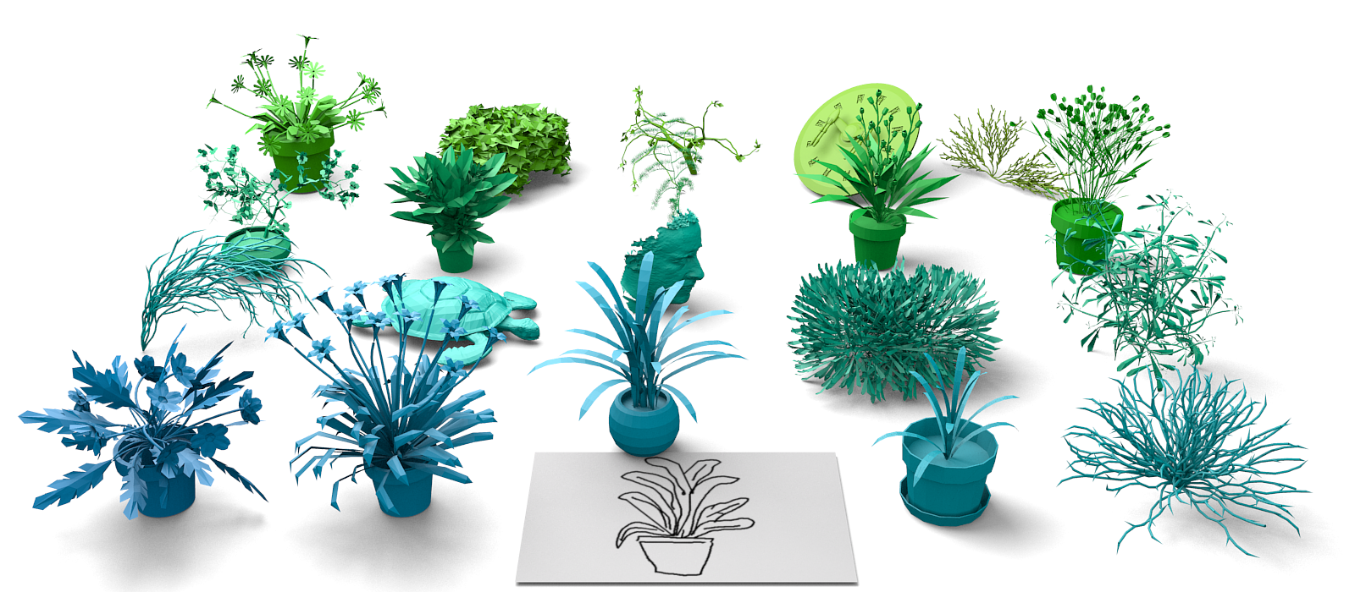
Conclusions
  Interactive sketch-based shape retrieval
    First benchmark for 3d shape retrieval
    New feature transform that outperforms existing approaches
    Dataset released to encourage further research

Slide 31
Thanks
Acknowledgements
  AMT users for their sketches
  James Hays for help with AMT
  Princeton Shape Benchmark [Shilane’04]
  RTSC tool by Doug DeCarlo, Szymon Rusinkiewicz
  Cited authors for images from their papers
See http://cybertron.cg.tu-berlin.de/eitz for:
  Dataset
  Demo

Slide 33
Parameter Optimization
Can apply same method to existing descriptors
[Funkhouser 2003]
[Yoon 2010]
original parameters
optimized parameters
Notes:
Spherical Harmonics: optimal parameters at 8 functions, 16 coefficients
Diffusion Tensor: optimal parameters at 12 tiles 4 bins
We can of course also apply the same optimization methods to optimize the parameters of existing systems. First we look at the Spherical Harmonics descriptor by Funkhouser et al., one of the very first systems for sketch-based 3D retrieval. This descriptor is governed by two essential parameters: number of circular functions as well as number of coefficients. Our optimization shows that the optimal parameter combination is very close to the one suggested in the paper. On the other hand, for the Diffussion Tensor descriptor suggested by Yoon et al. Our optimization clearly demonstrates that there exist better parameter settings than the ones proposed in the original publication.

Slide 34
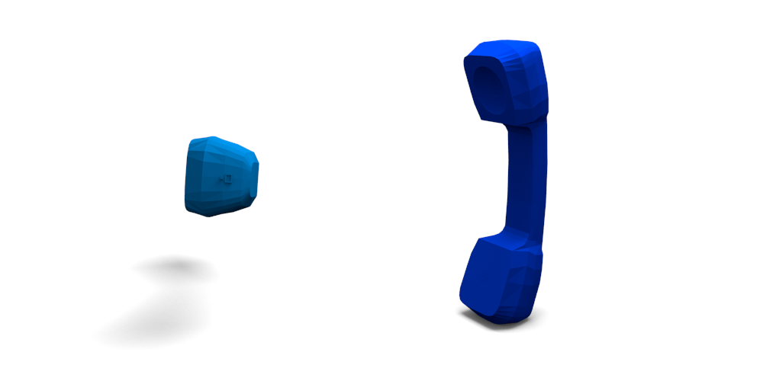

Best View Generation
Are all views equally likely to be drawn?
  Learn model of human viewpoint preference
  RBF SVM using the following features:
    projected area [Plemenos 96], depth smoothness,
    silhouette length [Secord 11]

Slide 35

Best View Generation
Predict best views for unknown model
a) probability map for model
b) resulting best view
c) user sketch

Slide 36
Comparison View Generation
number of sampled views

Slide 37
Parameter Optimization
Many parameters in our pipeline – best combination?
  Feature transform: #orientations, Gabor filter parameters
  Vocabulary size, feature size
Sampling the whole parameter space is not an option
  6-dimensional space, 10 samples: 10^6 samples
  Each sample takes one hour = 100 years
  Our solution: choose two free parameters, fix remaining
Notes:
So we now have this nice bag-of-features pipeline with a nice feature transform suitable for sketches but unfortunately is governed by a lot of parameters, for example all the parameters underlying the Gabor filter (orientations, bandwidth, peak-frequency) and the remaining parameters, i.e. vocabulary size, feature size and number of tiles used.

Slide 38
Parameter Optimization
Optimizing parameters of underlying GABOR filter
  x/y axis: bandwidth
  left to right: peak frequency
best parameter value

